Slide 1














HawkTU
Presented by Tabish | Arqam | Danish

Slide 2
Overview
HawkTU is a comprehensive e-commerce platform designed for seamless interaction between sellers and customers. It features distinct user views—seller dashboards and customer portals—catering to specific needs. HawkTU also includes a tracking page for all users to check order status.

Slide 3
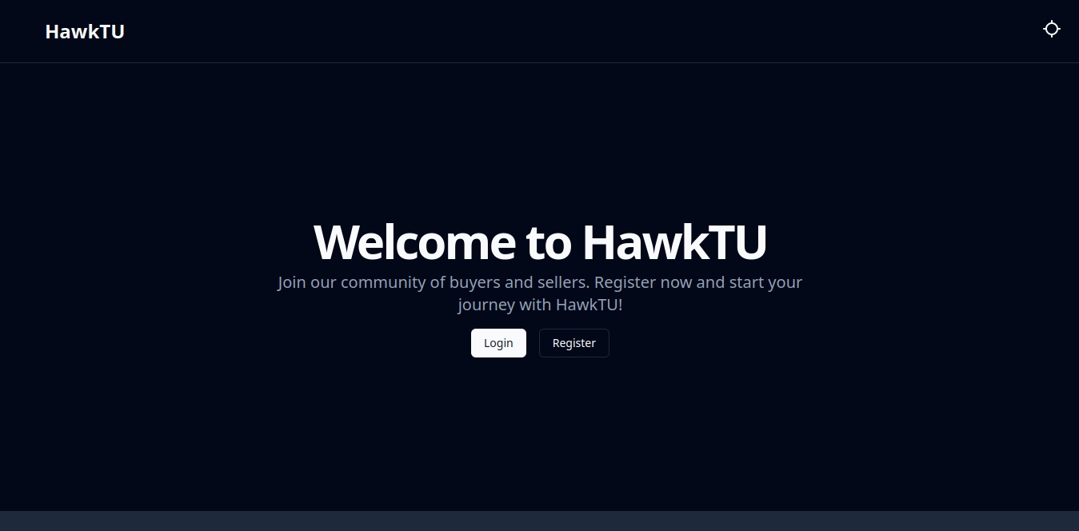
Landing Page

Slide 4
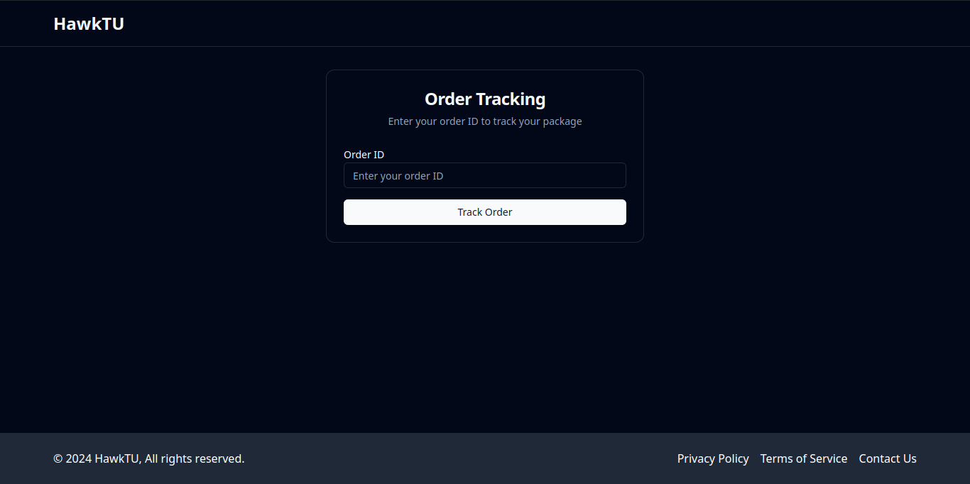
Tracking

Slide 5
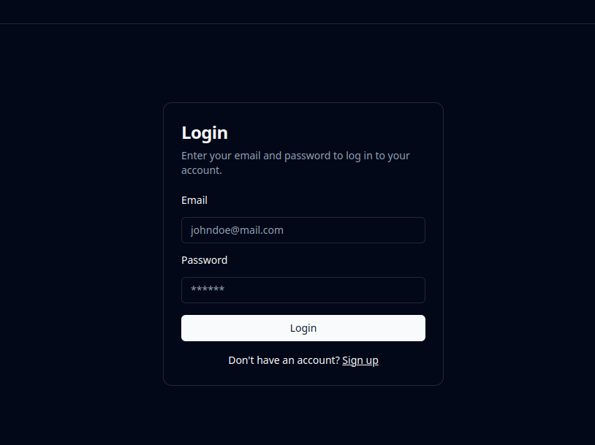
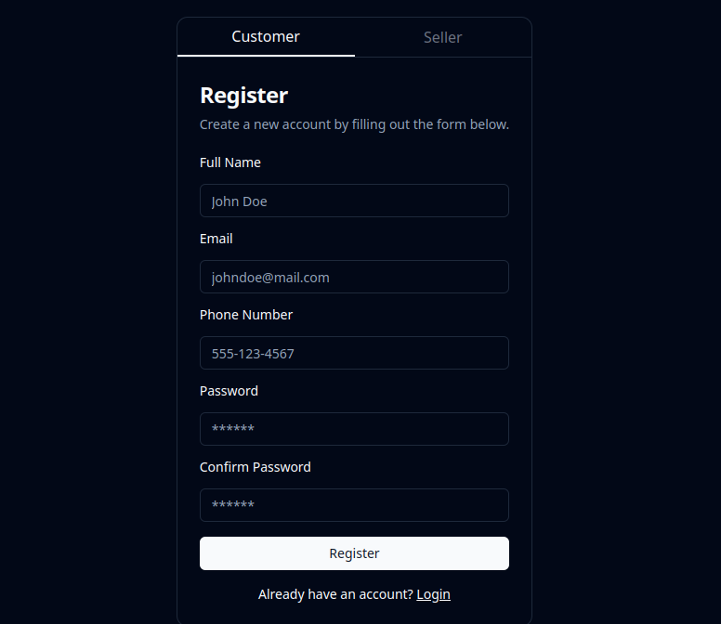
Login and Registration

Slide 6
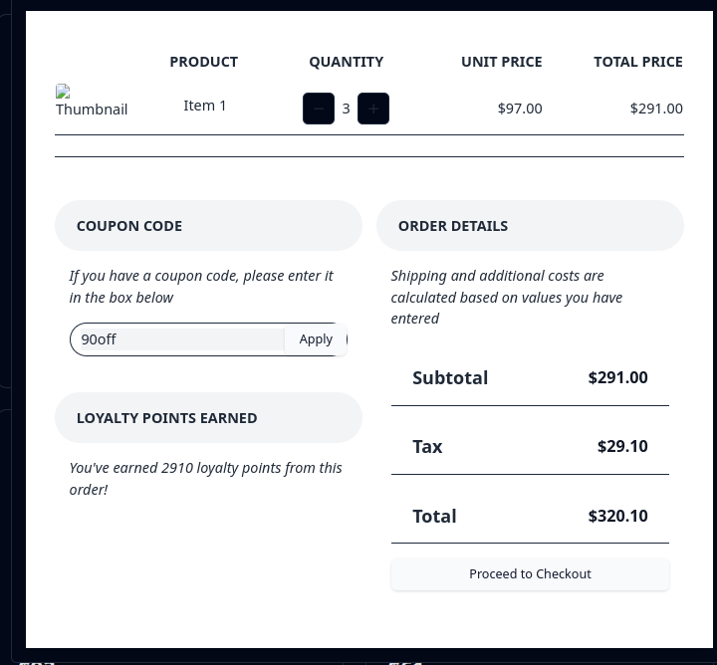
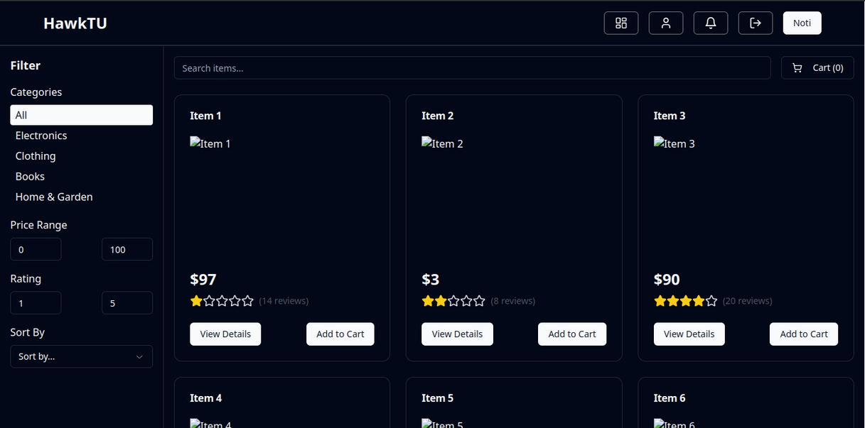
Shop and Cart

Slide 7
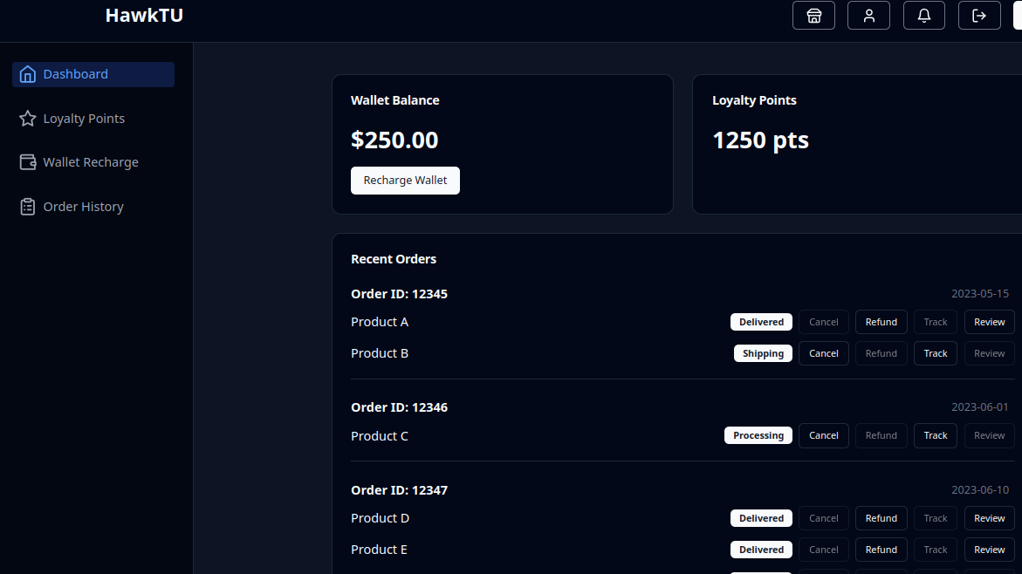
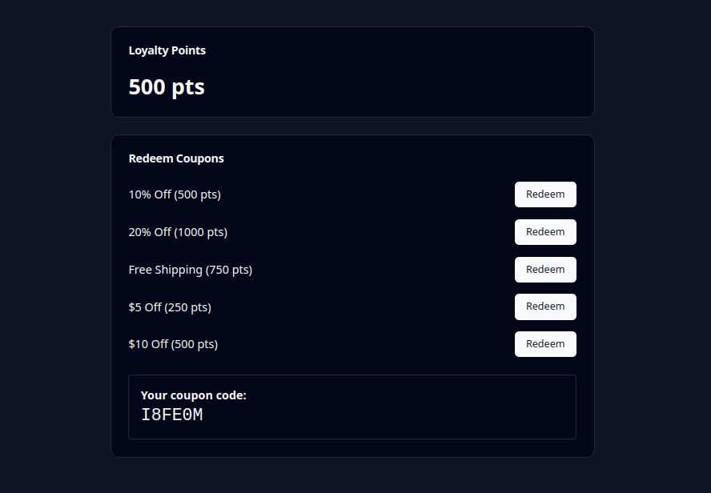
Customer Dashboard

Slide 8
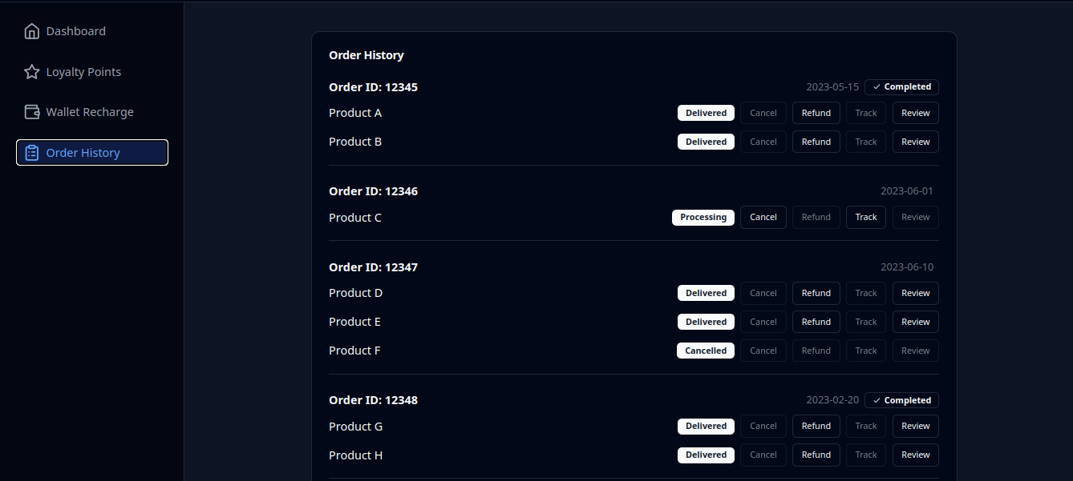
Order History

Slide 9
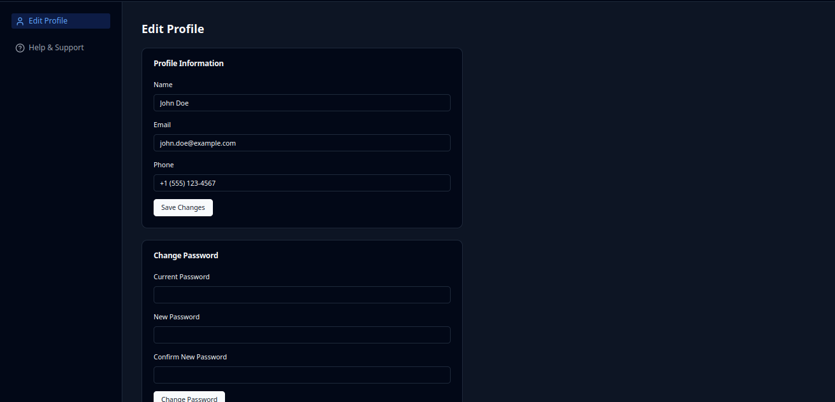
Customer Profile

Slide 10
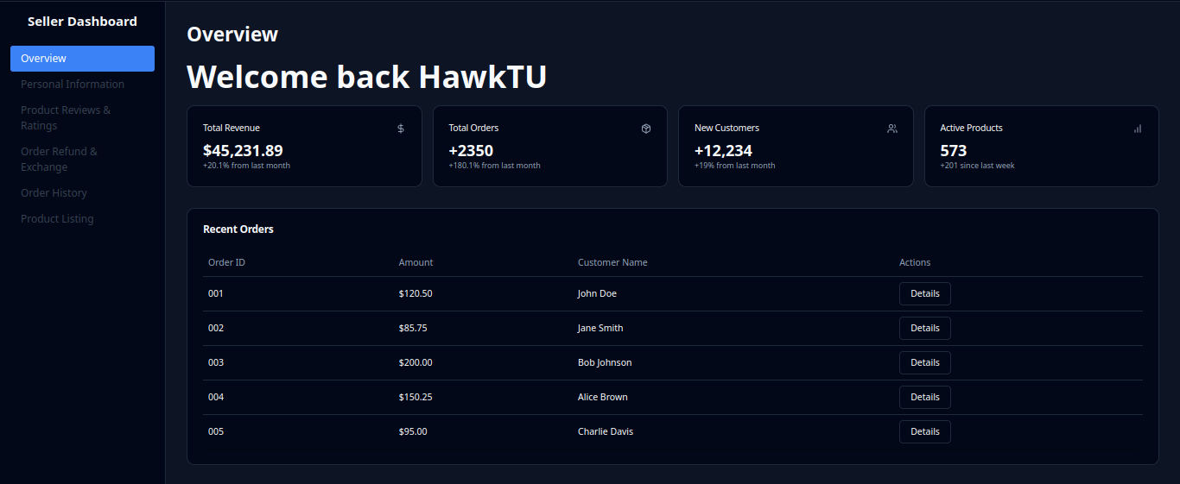
Seller Dashboard

Slide 11
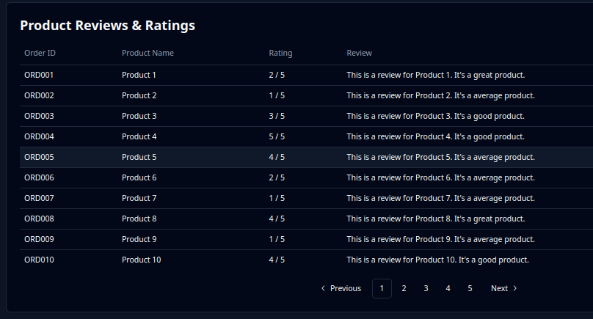
Review and Rating

Slide 12
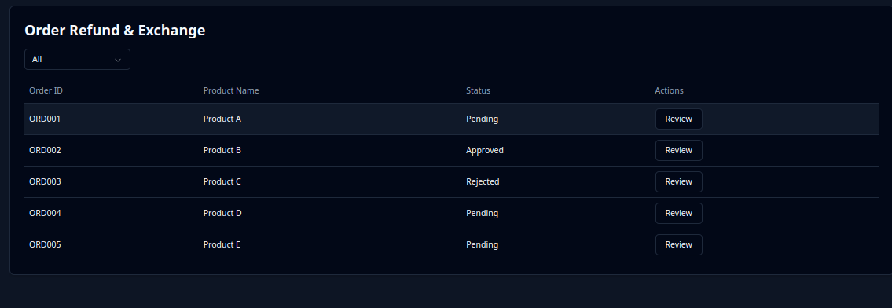
Refunds

Slide 13
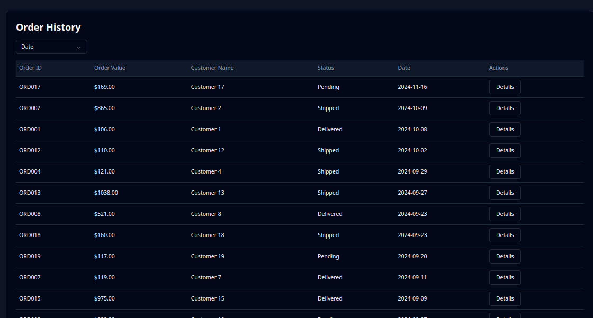
Seller Order History

Slide 14
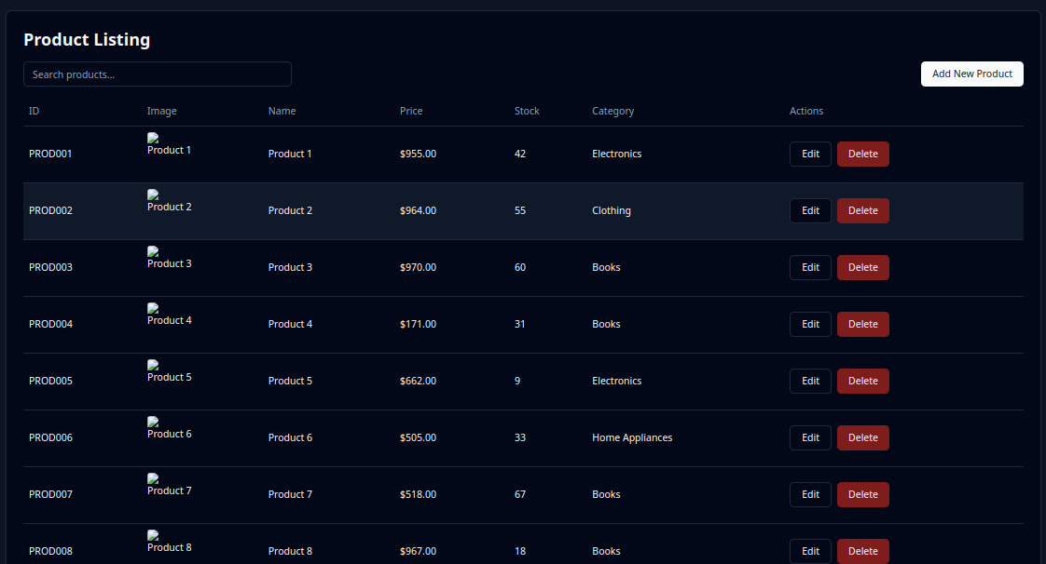
Product Listings

Slide 15
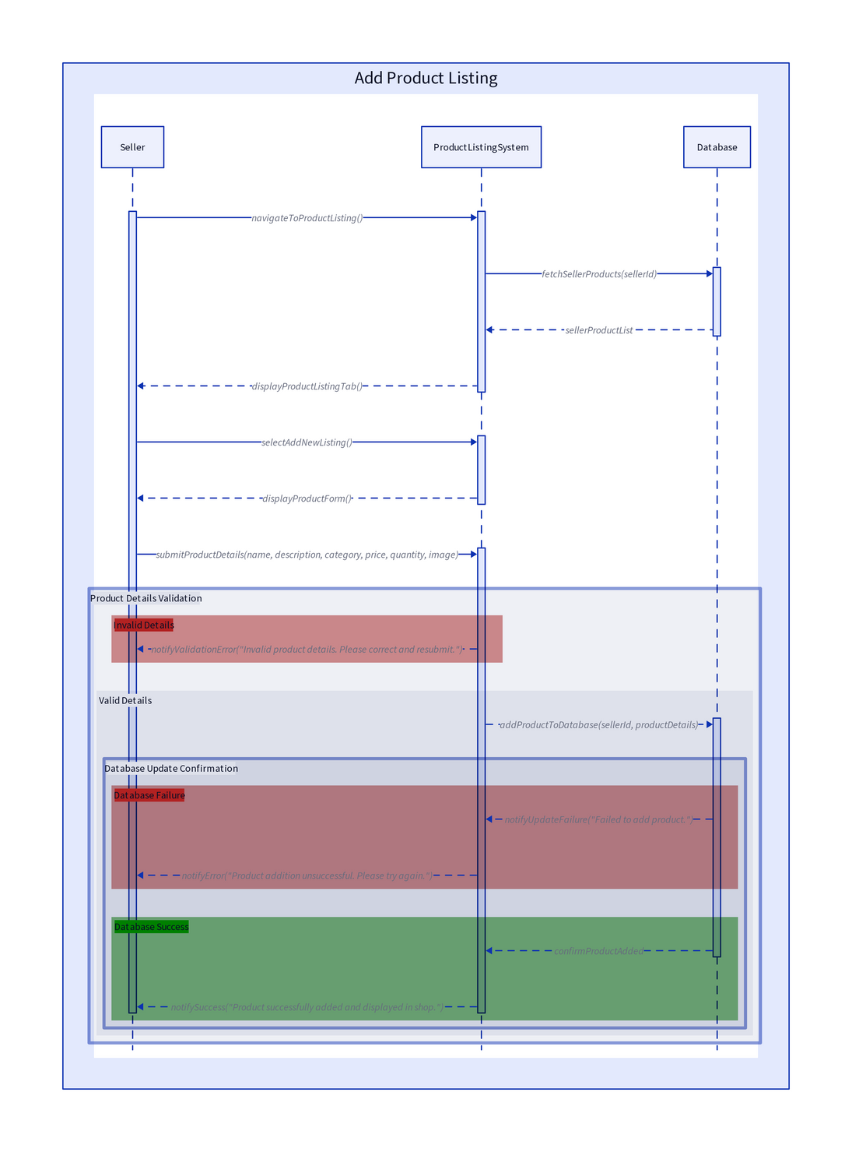
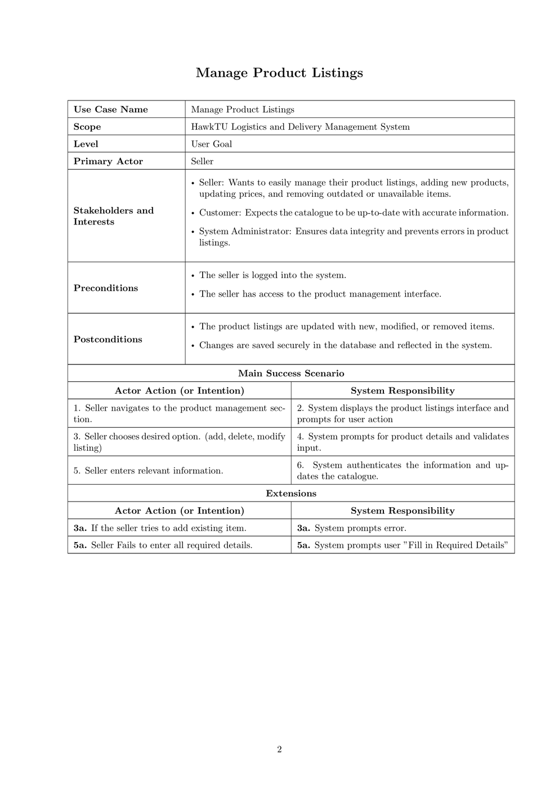
Use Case & Sequence Diagram

Slide 16
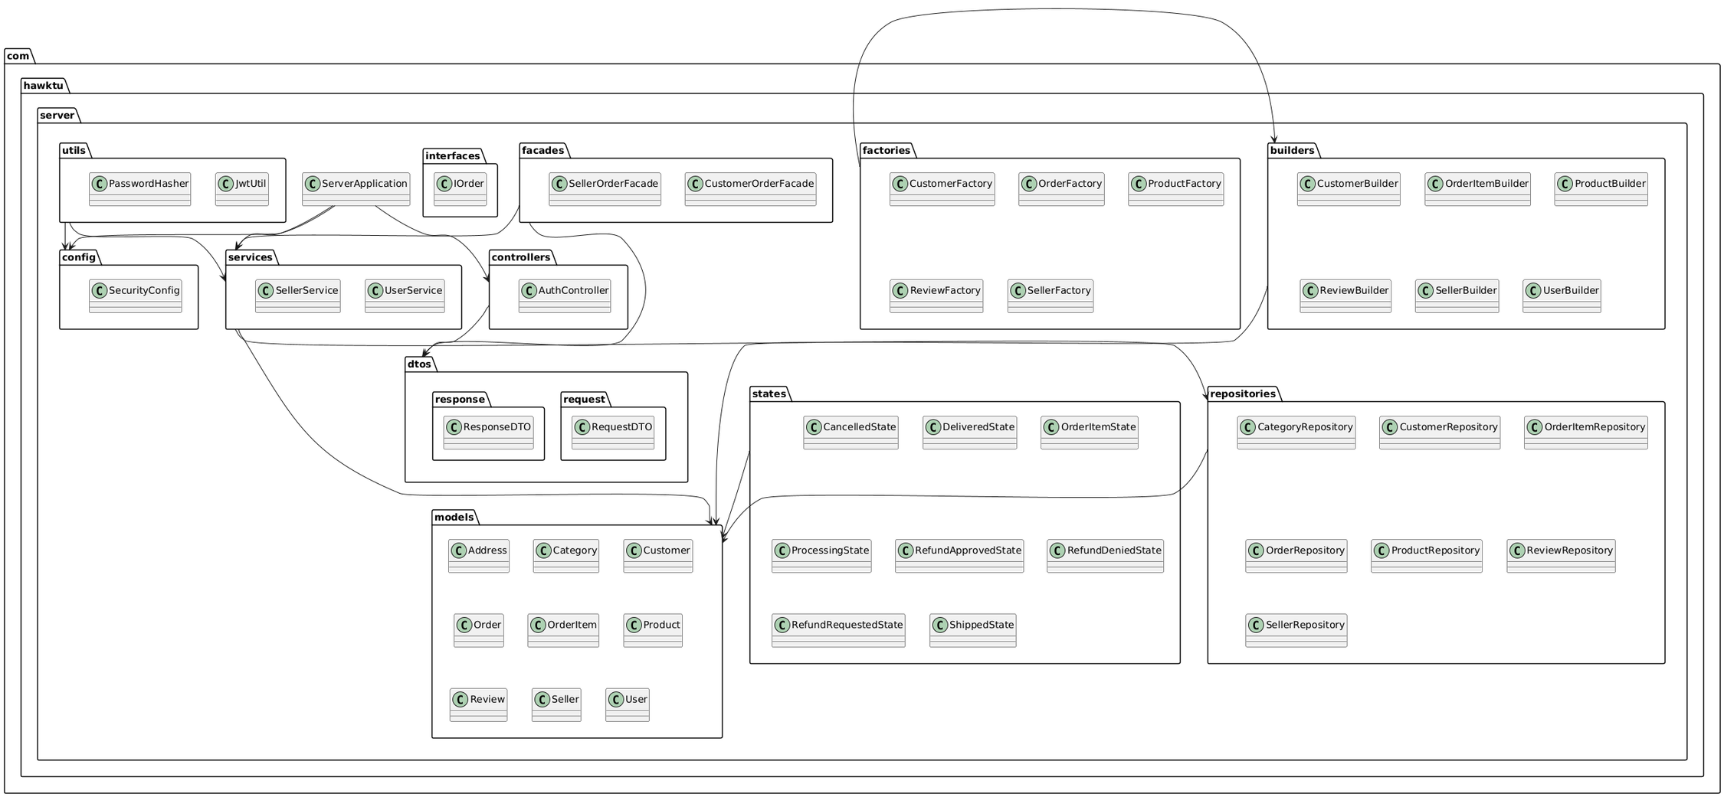
Package Diagram

Slide 17
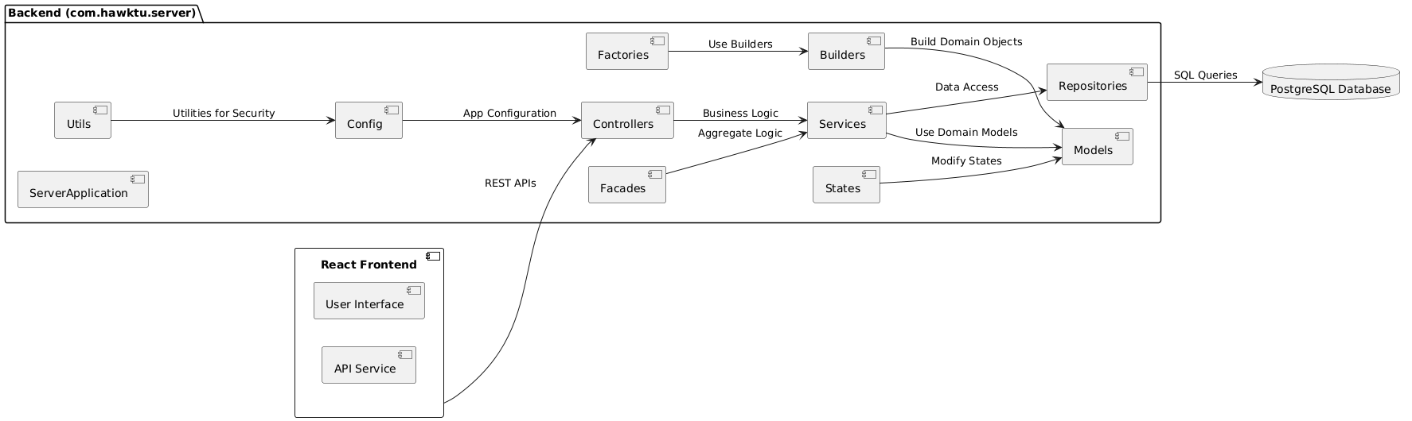
Deployment Diagram

Slide 18
Thank You

